Slide 1
Internet of Things + Protocol Stack

Slide 2
Various Terminology of IoT
Internet of Everything
Smarter Planet
Machine to Machine (M2M)
The Fog
Tsensors (Trillion Sensors)
The Industrial Internet
Industry 4.0
Internet of Things (IoT)

Slide 3
Communications
A “thing” always feature communications for “team working”
The Role of Communications
Providing a data link between two nodes
Communication type:
Wireline (e.g. copper wires, optical fibers)
Wireless (e.g. RF, IR). RF-based communication is the most popular choice
Popular RF-based communication solutions:
– IEEE 802.15.4
IEEE 802.11 (or Wi-Fi)
Bluetooth
Near Field Communication (NFC), e.g. RFID

Slide 4
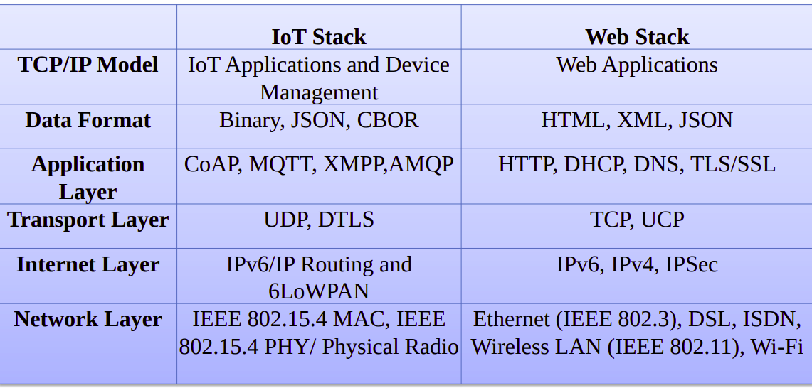
IoT Protocol Stacks
Source: LOGANATHAN V, Welcome to the Workshop on IoT & Cloud Computing the Coexistence . Available at https://slideplayer.com/slide/13103760/ and http://www.ismuniv.com/wp-content/uploads/2015/12/coexistance.ppt

Slide 5
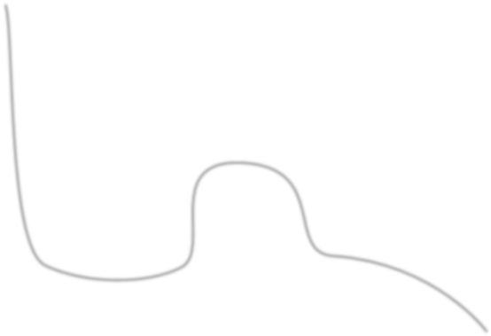



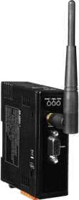
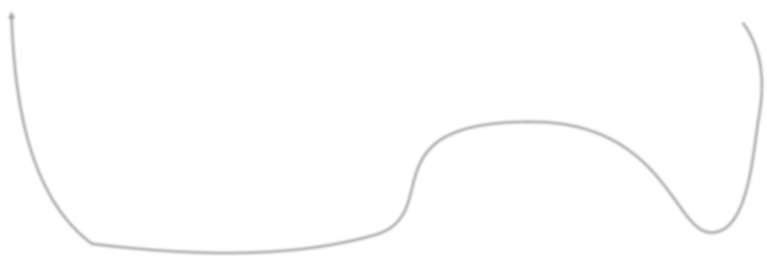
Protocol Stack Thing Thing
Application
Application
TCP/UDP
TCP/UDP
Network (IP)
Network (IP)
IEEE 802.15.4
PHY/MAC
IEEE 802.15.4
PHY/MAC
Wireless Medium
Server
Application
Gateway
TCP/UDP
Network (IP)
IEEE 802.3 IEEE 802.15.4
(Ethernet) PHY/MAC
Network (IP)
IEEE 802.3
(Ethernet)
The
Internet

Slide 6
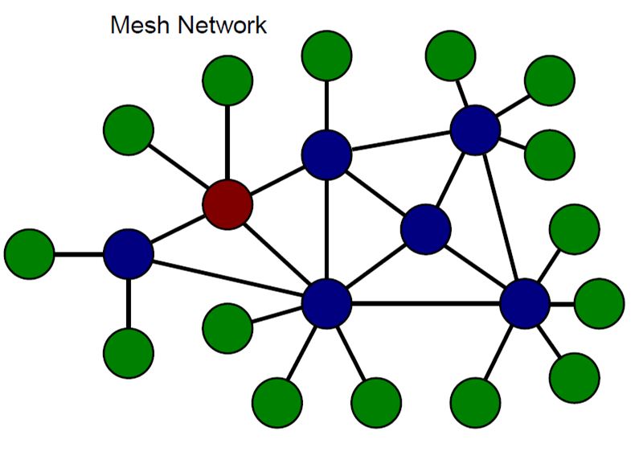
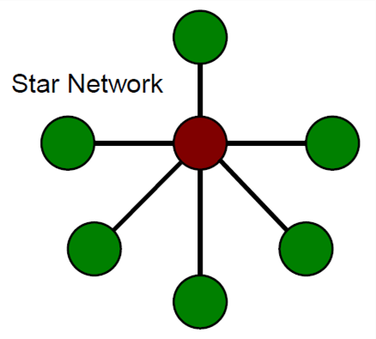
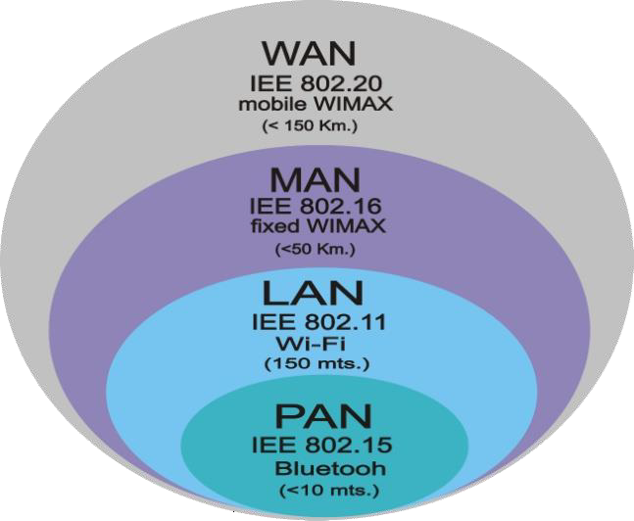
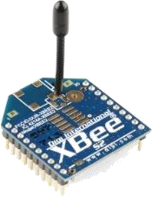
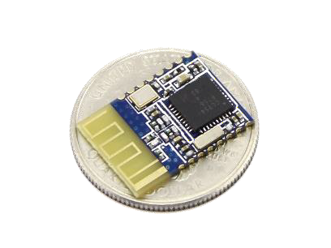
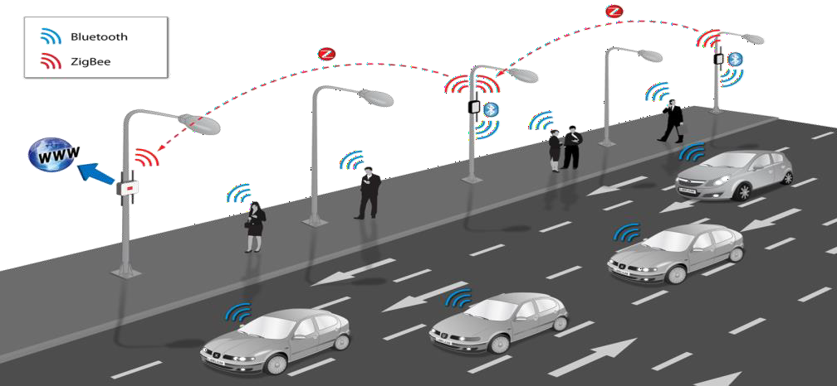
Enabling Technologies: Wireless technologies
Latency | ~2.5 ms | ~20 ms
Peak Current | ~ 12.5 mA | ~ 40 mA
Data Rate | ~305 kbps | ~100 kbps
Power Efficiency | ~0.153 μW/bit | ~185.9 μW/bit
Range | 280 m | 100 m
Network Topology | Star Network | Mesh Network
Source: http://ftp.onem2m.org/Meetings/TP/2015%20meetings/20150720_TP18_Philadelphia/TP-2015-0764-ITU-T_presentation_to_oneM2M_SC27.PPT

Slide 7
Link Layer Protocols
802.3 - Ethernet
802.11 - wifi
802.16 - WiMax
802.15.4 - Low Rate WPAN
2G/3G/4G - Mobile Communication

Slide 8
Network Layer Protocols
IPv4
Exhausted in 2011
32bit address
IPv6
128 bit addresses
6LoWPAN
Limited processing capability
Shows compression mechanism with IPv6 over 802.15.4

Slide 9
RPL - Routing Protocol for low power and lossy Networks

Slide 10
Introduction
Routing Requirements
RPL instance and DODAG
RPL Ranks
Route construction
Objective Function and Control messages

Slide 11
Low Power and Lossy Networks (LLN) are resource constrained
Routers are usually limited in terms of processing power, battery and memory, and their interconnects are characterised by unstable links with high loss rates, low data rates and low packet delivery rates
The traﬃc patterns could be P2P or P2MP or MP2P
Lossy means the packet drop rate will be high.

Slide 12
RPL is a distance vector routing proto
RPL mainly targets collection-based networks, where nodes periodically send measurements to a collection point.
The protocol was designed to be highly adaptive to network conditions and to provide alternate routes, whenever default routes are inaccessible.
RPL provides a mechanism to disseminate information over the dynamically formed network topology
Contains thousands of nodes…

Slide 13
RPL topology
DODAG (Destination Oriented Directed Acyclic Graphs)
A DODAG is a DAG rooted at a single destination. The DODAG root has no outgoing edges. A DODAG is uniquely identified by a combination of RPL Instance ID and DODAG ID.
Rank
A nodes Rank defines the nodes individual position relative to other nodes with respect to a DODAG root. Rank strictly increases in the Down¹ direction and strictly decreases in the Up² direction.
DODAG Root
The DODAG root is the DAG root of the DODAG. The DODAG root may act as a border router for the DODAG, and aggregate routes in the DODAG and may redistribute DODAG routes into other routing protocols

Slide 14
RPL control Messages
DIO - DODAG Information Object
DIS - DODAG information solicitation
DAO - Destination advertisement object (propagate destination information upwards)
DAO-ACK - DAO Acknowledgement (unicast packet by a DAO recipient)
CC - Consistency Check (Checking for consistency in the messages)

Slide 15
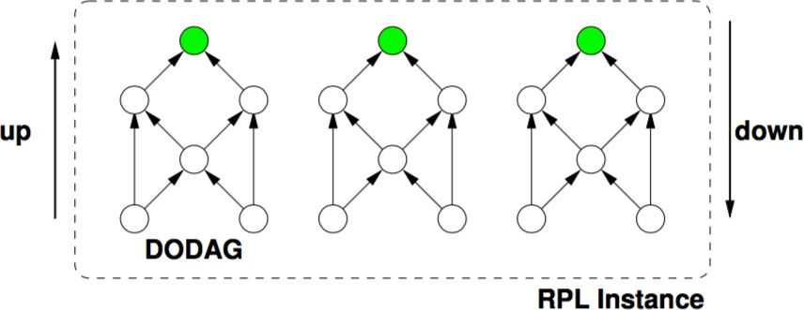
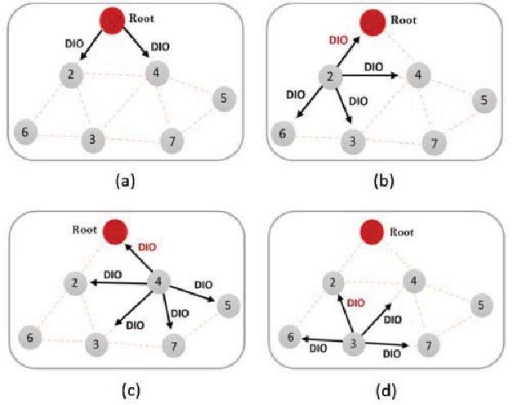
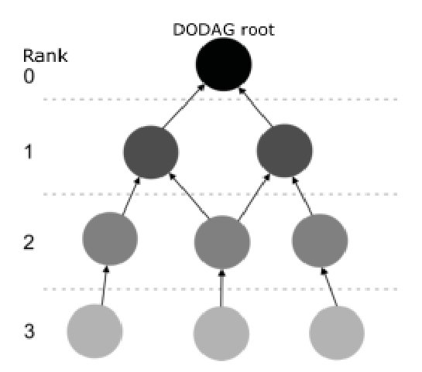
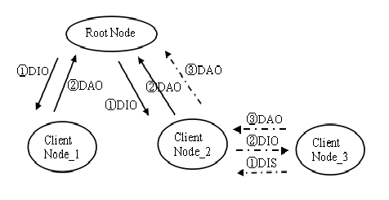

Slide 16
Upward path is so common (mp2p)
Downward path is optional mainly for p2p and p2mp
An RPL Instance consists of multiple Destination Oriented Directed Acyclic Graphs (DODAGs). Traﬃc moves either up towards the DODAG root or down towards the DODAG leafs

Slide 17
RPL instance
DODAGS are disjoint (no shared nodes)
Link properties: (reliability, latency, . . . ) \Node properties: (powered or not, . . . )
RPL Instance has an optimization objective
Multiple RPL Instances with diﬀerent optimization objectives can coexist

Slide 18
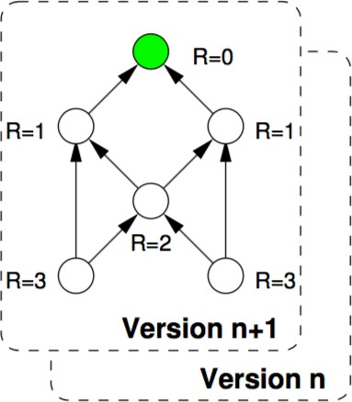
RPL Rank
A node’s Rank defines the node’s individual position relative to other nodes with respect to a DODAG root. The scope of Rank is a DODAG Version.

Slide 19
Forwarding and routing
Up routes towards nodes of decreasing rank (parents), Down routes towards nodes of increasing rank
Nodes inform parents of their presence and reachability to descendants.
All routes go upwards and/or downwards along a DODAG
When going up, always forward to lower rank when possible, may forward to sibling if no lower rank exists
When going down, forward based on down routes

